Slide 1
Handling Cache Misses
CSE-3109 Computer Architecture
Lecture 11

Slide 2
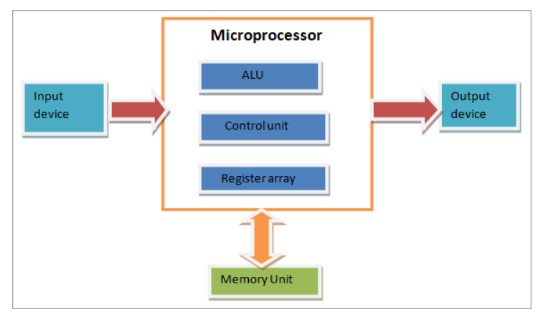
Things to Know
Block Diagram (structure of a Microprocessor)
During the execution of a program, the control unit fetches one instruction at a time from the main memory and then executes it.

Slide 3
Things to Know
Block Diagram (structure of a Microprocessor)
In this execution process, it takes help of ALU, if the instruction execution involves arithmetic or logical operation (like AND, OR, Ex-OR).
After execution of the current instruction, the control unit fetches the next instruction for execution.
This process continues until the program is completed and the result is output using the output device. In many computers, the control unit and the ALU are integrated into a single block, known as Central Processing Unit (CPU).

Slide 4
Handling Cache Misses
Cache miss: A request for data from the cache that cannot be filled because the data is not present in the cache.
The control unit must detect a miss and process the miss by fetching the requested data from memory (or, a lower-level cache).
If the cache reports a hit, the computer continues using the data as if nothing happened.

Slide 5
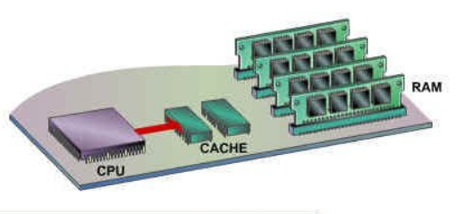
Multilevel Cache- (Things to know)
The cache is an extension of a computer’s main memory. Cache holds a copy of only the most frequently used information or program codes stored in the main memory. The smaller capacity of the cache reduces the time required to locate data within it and provide it to the CPU for processing. Cache memory, lies in between CPU and the Main memory.

Slide 6
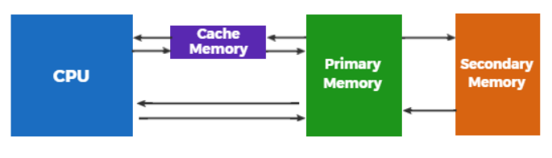
Multilevel Cache- (Things to know)

Slide 7
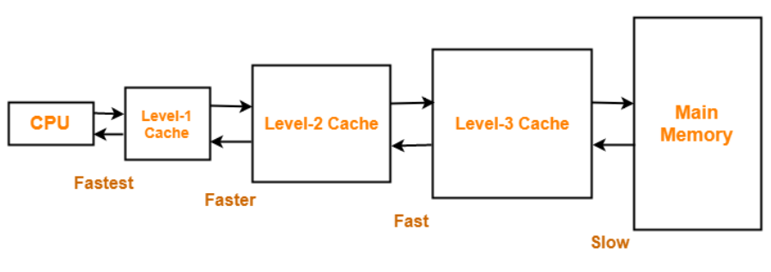
Multilevel Cache- (Things to know)
Cache hierarchy, or multi-level caches, refers to a memory architecture that uses a hierarchy of memory stores based on varying access speeds to cache data. Highly requested data is cached in high-speed access memory stores, allowing swifter access by central processing unit (CPU)
Three-level caches Cache Organization

Slide 8
Handling Cache Misses
The cache miss handling is done in collaboration with the processor control unit and with a separate controller that initiates the memory access and refills the cache.
For a cache miss, we can stall the entire processor, essentially freezing the contents of the temporary and programmer-visible registers, while we wait for memory.

Slide 9
Handling Cache Misses-Continue
We can now define the steps to be taken on an instruction cache miss:
Send the original PC value (current PC – 4) to the memory.
Instruct main memory to perform a read and wait for the memory to complete its access.
Write the cache entry, putting the data from memory in the data portion of the entry and turning the valid bit on.
Restart the instruction execution at the first step, which will refetch the instruction, this time finding it in the cache.

Slide 10
Handling Writes
Writes work somewhat differently. Suppose on a store instruction, we wrote the data into only the data cache (without changing main memory).
After the write into the cache, memory would have a different value from that in the cache.
In such a case, the cache and memory are said to be inconsistent.
The simplest way to keep the main memory and the cache consistent is always to write the data into both the memory and the cache. This scheme is called write-through.

Slide 11
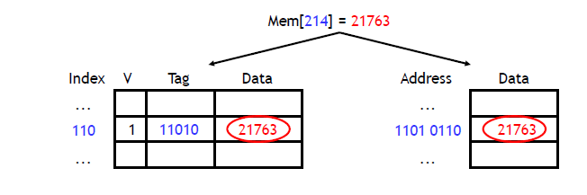
Write Through Caches
Write through is a storage method in which data is written into the cache and the corresponding main memory location at the same time.
The cached data allows for fast retrieval on demand, while the same data in main memory ensures that nothing will get lost if a crash, power failure, or other system disruption occurs.

Slide 12
Write Through Caches
Writes through always update both the cache and the memory, ensuring that data is always consistent between two.
Although write through minimizes the risk of data loss, every write operation must be done twice, and this redundancy takes time.

Slide 13
Write Through Caches
The active application program must wait until each block of data has been written into both the main memory and the cache before starting the next operation.
The "data insurance" therefore comes at the expense of system speed.
Write through is the preferred method of data storage in applications where data loss cannot be tolerated, such as banking and medical device control.

Slide 14
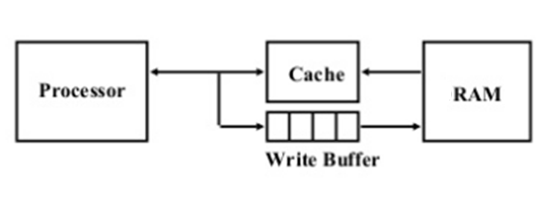
Write Buffer
A write buffer stores the data while it is waiting to be written to memory. After writing the data into the cache and into the write buffer, the processor can continue execution.
When a write to main memory completes, the entry in the write buffer is freed.
If the write buffer is full when the processor reaches a write, the processor must stall until there is an empty position in the write buffer.

Slide 15
Write Back or Copy Back
An alternative technique, known as write back, minimizes memory writes. With write back, updates are made only in the cache but does not immediately write the data through to main memory.
The hardware for a write-back cache is more complex, it has to remember which lines are inconsistent with main memory; these are said to be dirty.
When a data location is updated in write back mode, the data in cache is called fresh, and the corresponding data in main memory, which no longer matches the data in cache, is called stale.

Slide 16
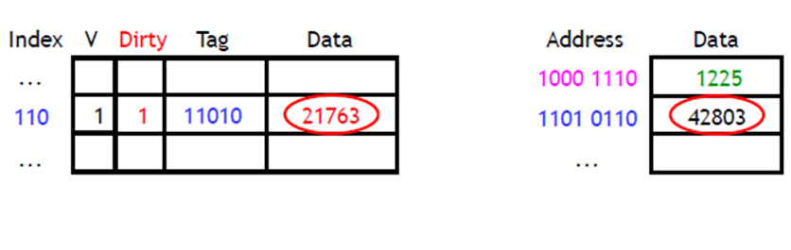
Write Back or Copy Back
If a request for stale data in main memory arrives from another application program, the cache controller updates the data in main memory before the application accesses it.

Slide 17
Write Back or Copy Back
Write back optimizes the system speed because it takes less time to write data into cache alone, as compared with writing the same data into both cache and main memory. However, this speed comes with the risk of data loss in case of a crash or other adverse event.

Slide 18
End

